Slide 1
Notes:
Welcome and thank you for your time

Slide 2
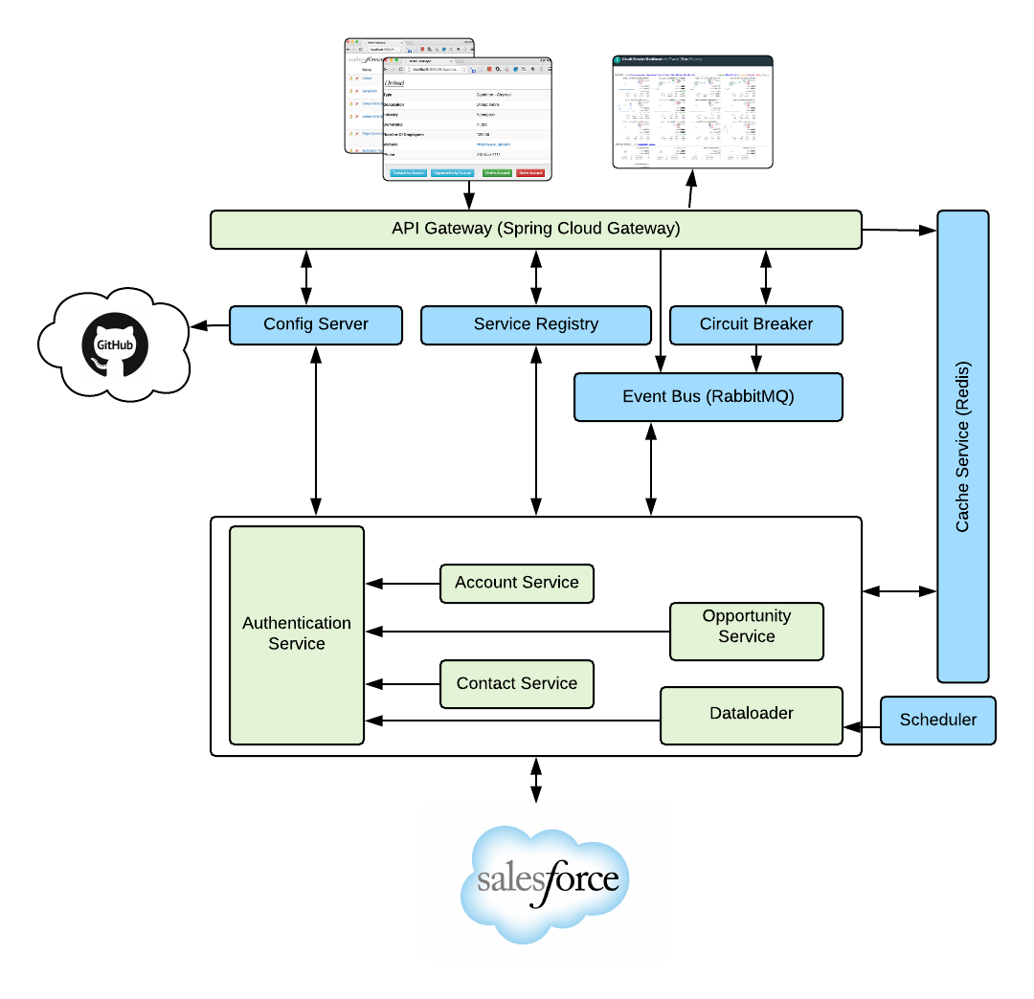
Demo Time
SFDC App built with Spring Boot and Spring Cloud Services components.
Microservices:
SalesForce web interface
API gateway service
Account data service
Contact data service
Opportunity data service
Authentication service
Backing Services:
Circuit Breaker Dashboard
Service Registry
Configuration management
Redis NoSQL database
RabbitMQ Messaging
Notes:
Now let’s show you Cloud Foundry in action with a demonstration app.

Slide 3

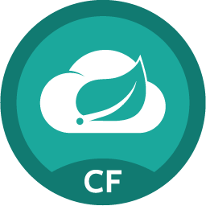


Spring Boot + Spring Cloud Services Suite
Config Server
How to build reliable Cloud Native systems from unreliable components?
Service Registry
Spring Cloud
Services
Circuit Breaker Dashboard
Notes:
Degrading Functionality
An essential part of building a resilient system, especially when your functionality is spread over a number of different microservices that may be up or down, is the ability to safely degrade functionality.

Slide 4
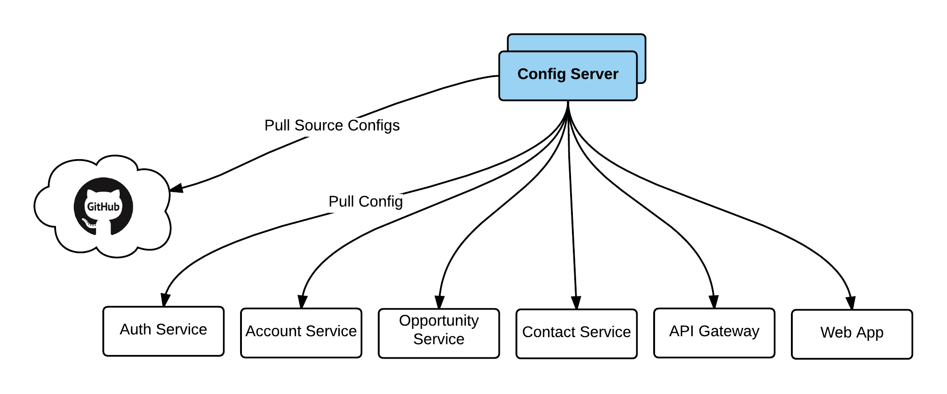
Config Server
Centralized Configurations
Integrates with SCM to provide non-repudiation audit and version control of configuration for easy roll-back
Supports for Data at Rest encryption
Support for on-demand/push notification configuration refresh without application restart

Slide 5
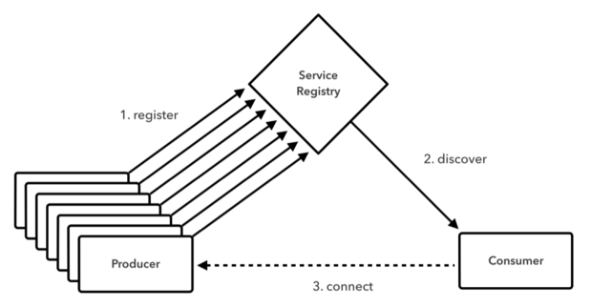
Service Registry
How does each micro-services discovers each other?
What information is provided during discovery?

Slide 6
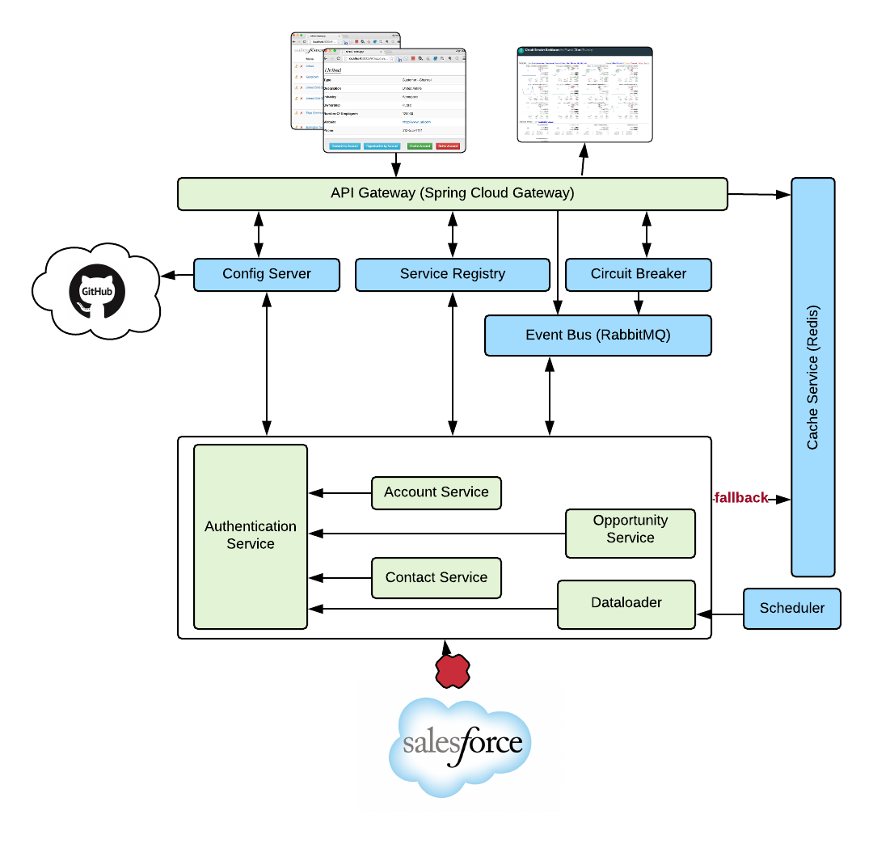
Circuit Breaker
What happens if external router is down??
Or what happens to your app when Salesforce.com has schedule maintenance??

Slide 7
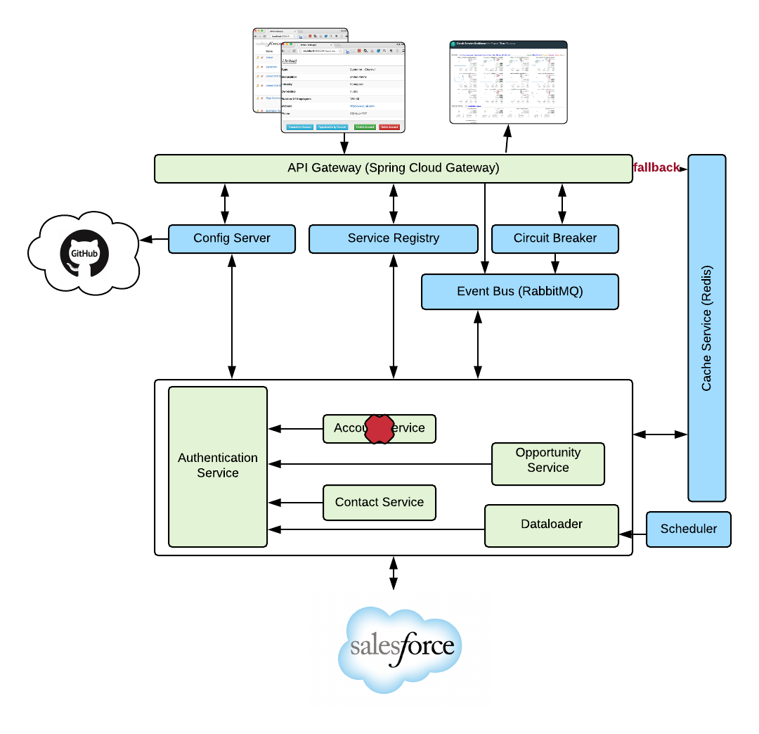
Circuit Breaker
What happens if external router is down??
Or what happens to your app when Salesforce.com has schedule maintenance??
Or one of the service is miss-behaving or down??

Slide 8
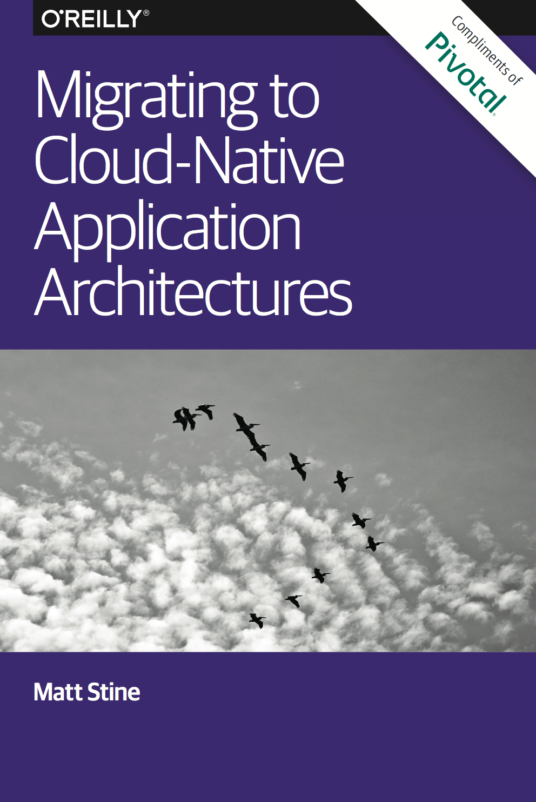
Looking to incubate a cloud native application model?
Application Framework
+
Platform Runtime
+
Infrastructure Automation
Complementary O’Reilly Book
http://bit.ly/cloud-native-book
Notes:
Looking to invest in cloud native applications? We wrote the book on it

Slide 9
Q&A
Notes:
AllState SVP Andy Zitney spoke at Summit on how Cloud Foundry brings their application development timelines from “100 days down to minutes”
Now I’d love to open this up for discussion.

Slide 10
Notes:
Time now for questions?
It’d also be great to discuss how you work with your operations team, to see if this

Slide 11
Traditional Model
Discovery: huge issue: mostly custom solutions, JNDI, etc.
Configuration: manual, error-prone, required app restarts
Dependencies & Resilience: co-bundling, EJBs, complex
Operators: no standardized process for deployment and management
Developers: low productivity due to complex environments and expensive context switching
Notes:
I as a developer I want to spin up a database on the fly

Slide 12
Microservice Model
Discovery: Service registry for discovery and credentials
Configuration: Config server for secure, versioned application configuration and updates
Dependencies & Resilience: Circuit breakers, platform services marketplace and 4 layers of health monitoring
Operators: Structured deployment model with a single API to manage operations tasks such as deploys and scaling.
Developers: Rich library of distributed system patterns

Slide 13
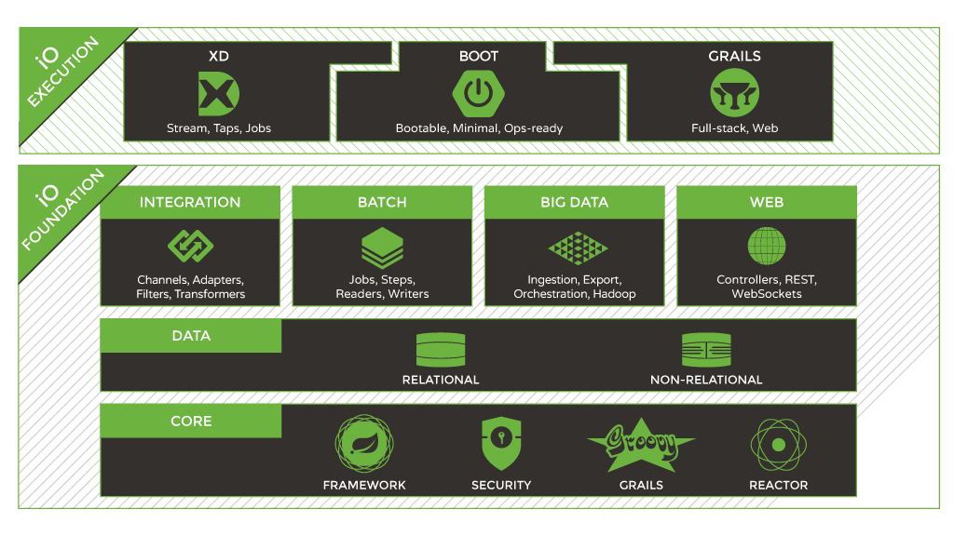

Spring IO Execution: Spring Boot
application configuration patterns
Convention-over-configuration, no XML, no code generation
Autoconfigure, embed servlet engine
Get out of the way quickly if you want to change defaults
Provide production ready features
Service Binding for Cloud Foundry
Java, Spring, Groovy
Notes:
It’s platform aware and provides an integrated spectrum of opinions, convention over configuration

